Slide 1
FINANCIAL RESULTS
FIRST QUARTER
2023
MAY 2023
THE HEART OF IT.

Slide 2
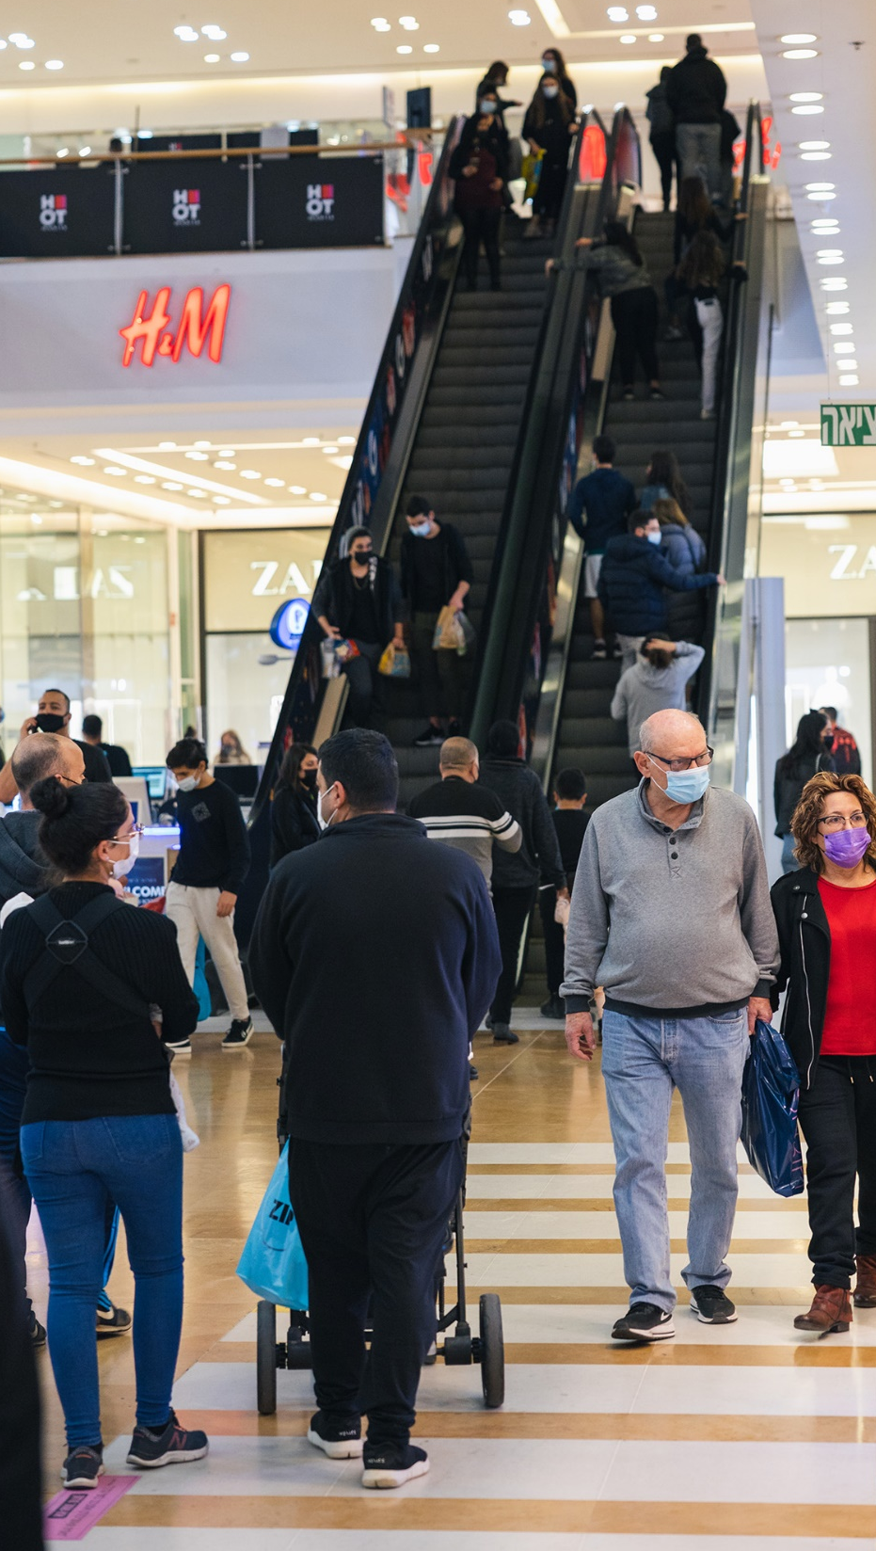
DISCLAIMER
This presentation includes the company's estimates that constitute forward-looking information as defined in Section 32A of the Securities Law (5778 - 1968), including forecasts, estimates, estimates, financial and operational data referring to future events whose realization is uncertain and not under the control of the company and its holding companies, forecasts and data In relation to the group's asset realization plan and asset financing (including the scope of realization and financing and expected schedules), to projects in planning and development, expected development schedules, investment plan, establishment costs and future revenues and other financial data, as well as to the effects of macroeconomic changes, including inflation rates, interest rates and exchange rates exchange. This information, as stated, is based on the company's subjective assessment which was made based on past experience and professional knowledge accumulated by the company, on the basis of existing information of the company and its held companies and in addition on the company's current expectations and assessments in connection with future developments and trends, and on their expected impact on the company's activities , and everything as known to the company at the time of publication of this presentation.
Although we believe that the assumptions on which any forward-looking statement is based are reasonable, any such assumption may prove to be inaccurate, and the statement based on such assumption may prove to be incorrect. Actual results and trends in the future may vary significantly from those presented or implied by any forward-looking statement in this presentation, depending on a variety of factors, including the risk factors that characterize the activities of the company and its held companies as detailed in the company's periodic report and in other information published by the company as part of its reports to the Israel Securities Authority, Including under the chapter "risk factors" in the company's periodic report, including economic conditions that affect geographic areas, changes in the rental policy of the marketing chains and substantial tenants, risks involved in activity in the field of property renewal and development, competition, increase in operating expenses and other expenses, developments in the economic and geopolitical environment in the areas of activity of the company and its holding companies, as well as developments in the real estate market, including paying attention to macroeconomic trends (including increases in inflation and interest rates in the economy as well as changes in exchange rates), to the COVID epidemic and its global and macroeconomic effects, as well as receiving regulatory approvals required to exploit the development potential, and the completion of the company's implementation plan, and therefore the results of the company's activities, may differ substantially from what is stated in this presentation.
With the exception of the obligation to disclose information as required by securities laws, we do not undertake to update any information contained in this presentation or publish the results of any changes to any statement that may be made to reflect events or circumstances that occurred, or that we became aware of, after the date of this presentation.
The information contained in this presentation does not constitute a prospectus or other offer document, and does not constitute or create any order or offer to sell or part thereof, or any solicitation of any order or offer to buy or subscribe to buy, any securities of G City Ltd. or Any other corporation, and in addition the information or any part of it or the fact of its distribution do not constitute a basis or possibility to rely on them in connection with any action, contract, obligation or in connection with the securities of the company.

Slide 3
FIRST HALF OF 2023
OPERATIONAL AND FINANCIAL PREFORMANCE – MAIN RESULTS
Proportionate NOI
(NIS Millions)
Increase Of Capital
(NIS Millions)
380
Equity per share
Approx. 10.3%
Increase in same properties NOI
+
380
NIS Million in the timeframe
The FFO¹ (NIS Millions)
Occupancy Rate
As of June 30, 2023
1.9)%(
+1.4%
Total
(1)FFO management approach for FFO in ISA approach see p.11.
(2)The figures are after the effect of hedging transactions and without a hybrid bond that is not CPI linked and carried a fixed interest rate.

Slide 4
FIRST HALF OF 2023 VS FIRST HALF OF 2022
OPERATIONAL AND FINANCIAL PREFORMANCE – MAIN RESULTS (Cont.)
Increase In Visitor Traffic This Quarter*
Increase in Same Store NOI this Quarter
6.8%
5.5%
3.1%
12.0%
7.2%
% 20.4
8.1%
6.9%
16.0%
Brazil
Israel
North Europe
Central Europe
Brazil
USA
Israel
North Europe
Central Europe
Average increase in visitor traffic this quarter*
Increase in Same Store NOI
כ- 5.4%
כ- 10.3%
Increase In Tenant Sales This Quarter*
Increase In Average Rent Price Per Sqm
(In Operational Currency)
8.1%
0.1%
4.1%
19.0%
43.3%
% 10.5
5.7%
1.7%
5.0%
Brazil
Israel
North Europe
Central Europe
Brazil
USA
Israel
North Europe
Central Europe
כ- 7.1%
Average increase in tenant Sales this quarter
כ- 7%
Average Increase In Rent Price Per Sqm
*Visitor data and tenant sales are not shown for the US since they are irrelevant to the US portfolio.
4

Slide 5
About G City 2023
THE HEART OF IT.
NIS 37 Billion
Value of Investment and Development Real Estate
10.3%+
Increase of same store NOI in 2023
94.9%
Occupancy Rate
CPI Linked Lease Agreements
Above 90%
Lease Agreements
~7,000
88
Assets As of
June 30, 2023
2,950
Units for Rent in Different Stages
1.9 Million SQM
GLA
5
G city | rishon lezion
5

Slide 6
URBAN ASSET PORTFOLIO PROVIDING DAILY NEEDS AND INTEGRATING RESIDENTIAL FOR RENT
Geographic Diversification Based on Proportionate Investment Property Value
Tenant Mix Based on Proportionate NOI
Quality Assets Portfolio Supermarket Anchored Assets in Densely Populated Urban Areas, Not relied On Dominant Tenants
80% Of G City’s Assets Are Located In 16 Metropolitan Areas
Tel Aviv
Boston
New York
Warsaw
Prague
Stockholm
Helsinki
Sau Paulo
6
Notes:
הקניונים שלנו מתאימים את עצמם למציאות משתנה וערוכים לפעילות מלאה
תיק נכסים אורבאני המשרת צרכים ושירותים יומיומיים, מפוזר גיאוגרפית וללא תלות בדיירים מהותיים

Slide 7
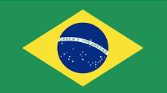
First Quarter of 2023
THE HEART OF IT.
Key Items in Wholly Owned Companies
 | Israel | North America | Brazil | Central Europe | Total
GLA (‘000 SQM) | 161 | 118 | 176 | 403 | 858
# of Income Producing Assets¹ | 13 | 19 | 7 | 14 | 53
Occupancy Rate | 97.9% | 91.7% | 94.3% | 93.8% | 94.4%
Investment Property (NIS Million) ¹ | 3,606 | 2,428 | 2,813 | 7,904 | 16,751
Investment Property Under Development and Land (NIS Million) ¹ | 1,226 | 1,480 | 70 | 1,069 | 3,845
Uses | Commercial, Office, Residential and Services | Commercial, Office, Residential and Services | Commercial, Office & Services | Commercial, Office, Residential and Services | -
Including assets in shared control.
7
Promenada | Warsaw

Slide 8
Disposition Plan for Non-Core Assets (Expanded Solo)
THE HEART OF IT.
Status of Asset Sales Since October 2022 until the date of publication of report
Total | In Marketing | In Advanced Stages of Negotiations | Completed or Under Binding Agreements | NIS Millions
4,938 | 2,073 | 1,085 | 1,780 | G Europe
145 | 145 | - | 154 | Israel
- | - | - | 528 | Gazit Horizons
739 | 241 | - | 498 | Gazit Brazil**
6,504 | 2,459 | 1,085 | 2,960 | Total
Commitment to promotion and completion of the sales process
Reducing the exposure to Brazil and Central Europe
Targeting properties located in the centers of main cities in super urban areas
Binding sales agreements in the amount of ~ NIS 3 billion from October 2022 until the date of publication of report, and ~NIS 1.1 billion under non-binding intent agreements
*The data above includes information on an asset realization plan, which is forward-looking information within the meaning of the Securities Law. The aforementioned data are based on the company's estimates as of this date and may change in the future as a result of the realization of various risks as well as a result of macro-economic changes and events, including in the real estate markets. For more details, see slide 2.
Promenada | warsaw
8

Slide 9
Latest Developments
During the Period of the Report Up to the Date of Publication
In April, G Europe sold its entire property portfolio in Russia, in exchange for about 131 million euros (about 524 million NIS).
In April, G Europe completed a combined process of purchasing the partner's share (25%) in the Arkady Pankrac property located in the city of Prague, Czech Republic and receiving financing for the entire property, for a period of approx. 5 years from a local bank. The free flow generated by the completion of the process is approx. EUR 52 million (approx. NIS 208 million).
In May, G Europe sold the property Palace Pardubice in the eastern Czech Republic, in exchange for approx. EUR 123.8 million (approx. NIS 496 million), similar to its book price.
שמירת התרוםIn July, Gazit Brazil completed the sale of its share (33%) in the Cidade Jardim shopping center in São Paulo, Brazil for approximately BRL 562 million (approximately NIS 425 million).
In July, the company completed the issuance of convertible bonds in the amount of approx. NIS 414 million.
In July, G Europe signed a Letter of Intent (LOI) to sell a property in Prague for approx. EUR 265 million (approx. NIS 1.1 billion) to an institutional buyer and Gazit Brazil received a binding offer to sell its holding (4.3%) of the El Dorado property in Sao Paulo for approx. BRL 93 million (approx. NIS 73 million)
Kfar Saba | Israel
9

Slide 10
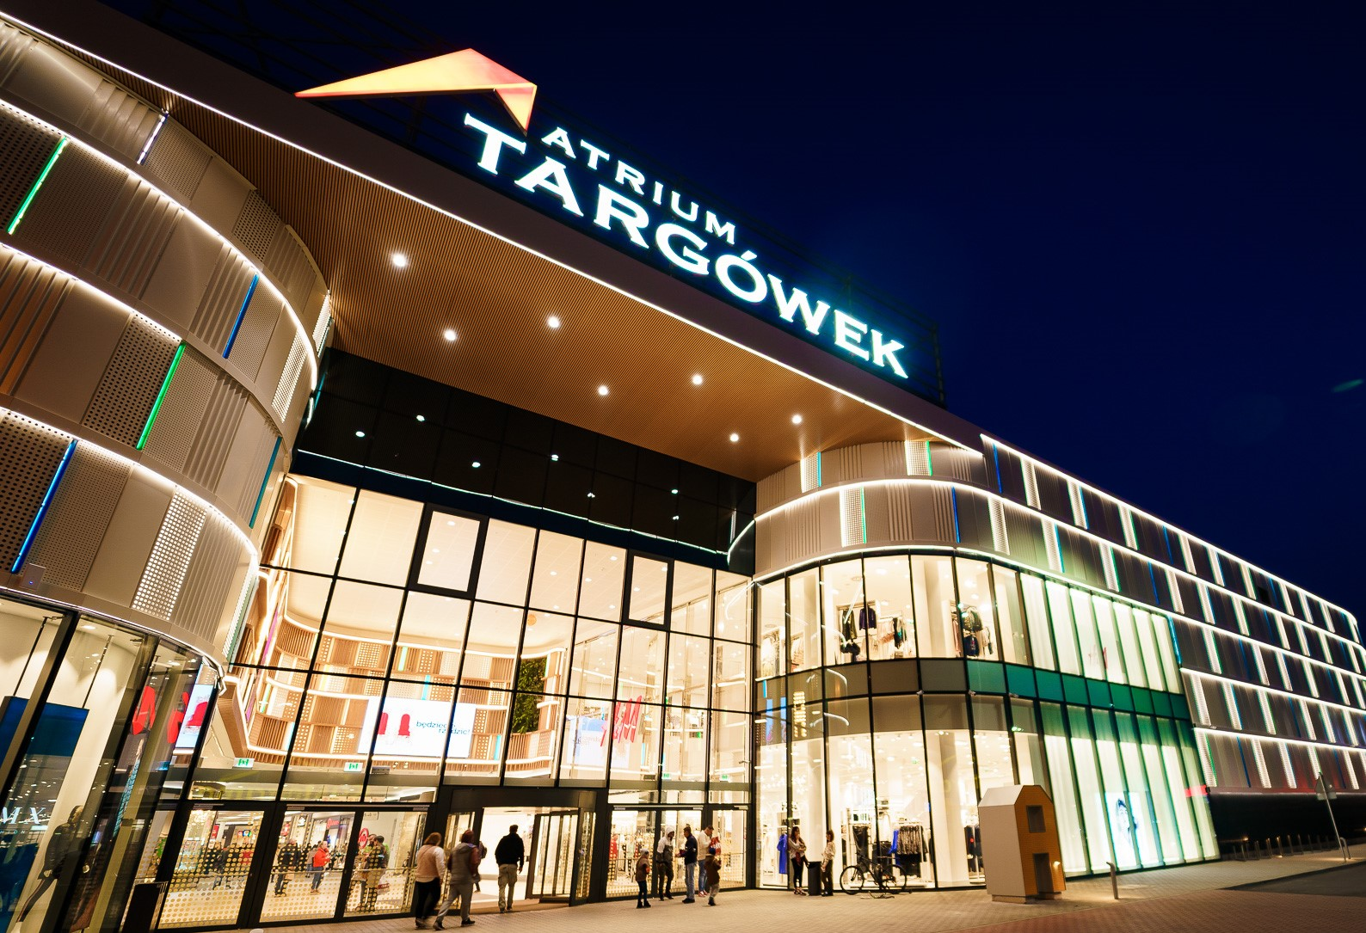
Results and Financial Data
THE HEART OF IT.
Second Quarter 2023
10
TARGOWEK | WARSAW
10

Slide 11
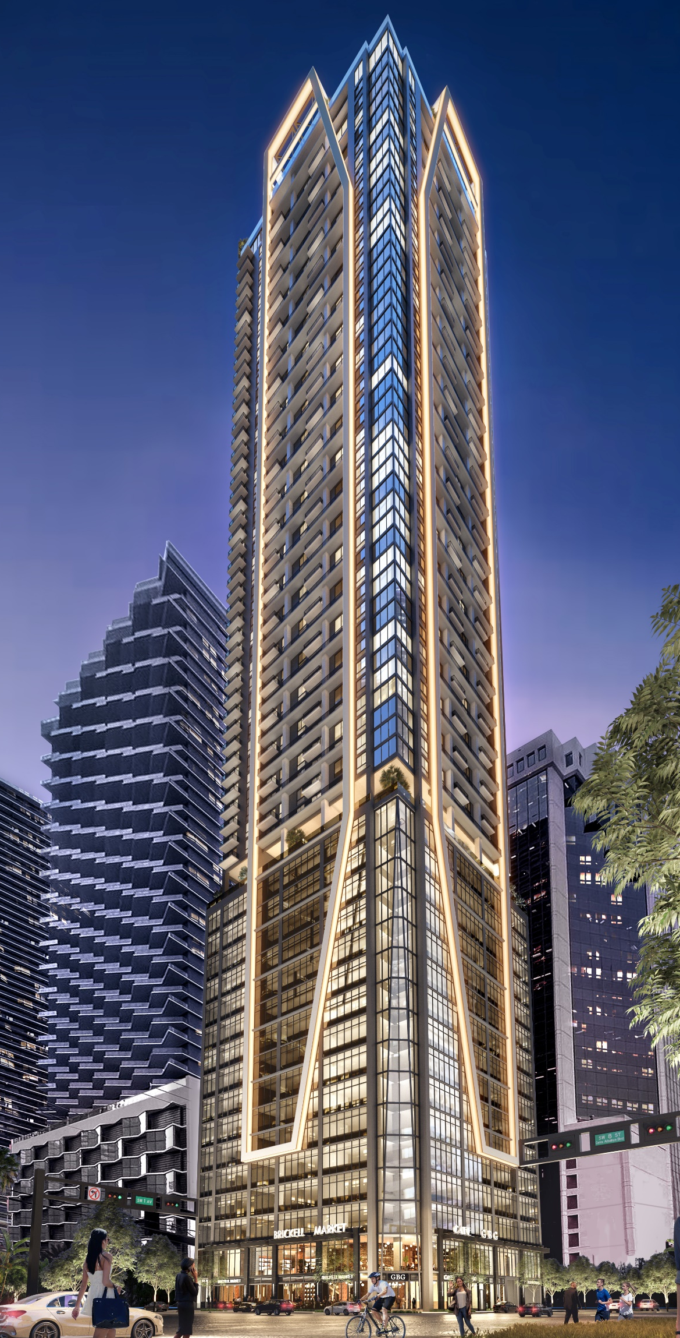
Second Quarter of 2023
Main Results
NIS Millions | 3-6/22 | 3-6/23 | Change | 1-6/22 | 1-6/23 | Change
Proportionate NOI | 336 | 337 | 0.3% | 642 | 680 | 5.9%
Same Store NOI | 255 | 279 | 9.1% | 490 | 541 | 10.3%
FFO according to the management approach | 144 | 112 | (22.2%) | 208 | 204 | (1.9%)
FFO according to the Securities Authority approach | (45) | (8) |  | (103) | (5)
CPI linkage and exchange rate differences | 197 | 141 |  | 322 | 252
Other adjustments and depreciation* | 17 | 8 |  | 38 | 14
Hybrid Bond Coupon | (25) | (29) |  | (49) | (57)
FFO according to management approach** | 144 | 112 |  | 208 | 204
*Revenues and expenses that were adjusted from the net profit (loss) for the purpose of calculating the economic FFO, which mainly include one-time expenses resulting from the termination of contracts with senior employees in the group, reorganization expenses in the group, share-based salary.
**Starting with this report, the company stopped neutralizing the profit/loss component from the early redemption of interest-bearing debt from the FFO calculation, and this in light of the wide-ranging realization plan announced by the Company and the Company's plan to use part of the proceeds for repurchases of the group's bonds, which are traded at a significant discount in relation to the pledged value (in accordance with the company's own purchase plan). The FFO data shown above in relation to the comparison periods has been adjusted to the updated method of calculation.
Brickell | Miami
11
Notes:
שקף 12 – תוצאות עיקריות
תודה חיים, שלום לכולם ותודה שהצטרפתם לשיחת הועידה, אעבור על התוצאות בקצרה,
מבחינת התוצאות התפעוליות כפי שחיים ציין הייתה לנו שנה עם עלייה בכל הפרמטרים התפעוליים,
ה- NOI באיחוד יחסי ללא שינוי בשע"ח עלה בכ- 24% לעומת הרבעון המקביל אשתקד והסתכם ב- 1.3 מיליארד ש"ח, התרומה של אטריום ניכרת ל- NOI ולמרות מכירת נכסים השנה ה- NOI צמח בצורה משמעותית.
ה- NOI מנכסים זהים, זהו הנתון החשוב ביותר להבנת תפעול הנכסים, עלה בשנה בכ- 14.3% לעומת
אשתקד.
מבחינת ה- FFO אנחנו מסיימים את השנה באמצע טווח התחזית שהצגנו וה- FFO ללא שינוי בשע"ח בשנת 2022 נותר יציב והסתכם בכ- 400 מיליון ₪, ה- FFO ברבעון הסתכם ב- 71 מיליון ש"ח, חשוב לי להדגיש כאן, הרבעון הרביעי לא מייצג את הקצב של ה- FFO ברבעונים הבאים, כיוון ויש פערי עיתוי שהשפיעו על הוצאות המימון. ברבעון הרביעי ישבנו על יתרות חוב גדולות וטרם התחלנו בהורדת החוב כפי שתיכננו. אני מאמין ש- GOING FORWARD אנחנו נראה יציבות בהוצאות המימון ואף קיטון מחד בגלל הקטנת קווי אשראי, תשלום אג"ח שוטף וקניות עצמיות של אג"ח שאנו מבצעים ומאידך כ- 85% מהחוב שלנו הינו בריבית קבועה כפי שאפרט בהמשך.
אני עובר לשקף 31 למאזן

Slide 12
Financial Strength
Key Items
As of June 30, 2023
67.1%
60.1%
3.62
Years
3.97%
Net Debt to Total Assets
(Expanded Solo)
Net Debt to Total Assets
(Consolidated)
Average Interest Rate of Debt
(Expanded Solo)
Debt Weighted Duration
(Expanded Solo)
Financial Flexibility
Liquidity (NIS Billions)
Bond Maturity Schedule
Until End of 2024 including G Europe (Formerly Atrium)
Unencumbered assets in wholly owned private subsidiaries
(NIS billions)
As of June 30, 2023
1.5
(NIS Billions, As of June 30, 2023)
NIS Billions
After the cut-off date:
The company completed a sale of a property in Brazil for ~NIS 425 million.
The company issued convertible bonds in a scope of ~NIS 414 million
NIS 7.4 billion
Cumulative to the end
2024
2.3
NIS Billions as of report publication date
Notes:
שקף 14 – שמירה על מאזן יציב ואיתנות פיננסית
תודה חיים, שלום לכולם ובוקר טוב מסאו-פאולו ברזיל.
לפני שאתחיל ביתרות המאזניות, הנזילות ואעבור לתוצאות אני רוצה לספר לכם שאני נמצא בסאו-פאולו והמצב כאן מאוד מעודד, הנכסים פתוחים וכפי שראינו בישראל לאחר ההקלות בסגר הקונים חוזרים לקנות ולבלות במרכזים המסחריים.
בשבוע שעבר השלמנו בהצלחה את גיוס החוב הראשון שלנו בברזיל במטבע מקומי, גיוס אשר זכה לביקושים חזקים ממשקיעים מקומיים ונסגר במרווח של 170 נקודות בסיס מעל האגח הברזילאי במחמ דומה.
החוב בריבית של 5.89% במחמ ארוך של 9.4 עוזר לנו להרחיב את מקורות הגיוס שלנו, כמו גם להפחית את עלות החוב שלנו, להתאים את מקורות ההון והחוב לשימושים שלהם יועדו, ולהפחית את הצורך בגידור המטבע.
לסוף הרבעון יתרות המזומן ושווה המזומן עמדו על כ- 1.1 מיליארד ש"ח, המינוף סולו מורחב ירד בכ- 0.6% ועומד על כ- 61.2% לעומת כ- 61.8% לתום שנת 2020, אנחנו מממשיכים לפעול להורדת המינוף, הן באמצעות התכנית האסטרטגית למכירת נכסים שאינם נכסי ליבה והן באמצעות הנפקת האקוויטי בברזיל.
כיום, מח"מ החוב הממוצע שלנו עומד על כ- 4.1 שנים והריבית הממוצעת על כ- 3.5%.
למועד פרסום הדוחות הכספיים יתרות הנזילות שלנו עומדות על כ- 2.4 מיליארד ש"ח לאחר תאריך המאזן כפי שחיים ציין קיבלנו את התמורה ממכירת הנכס בגרמניה בסך של כ- 87 מיליון אירו וקיבלנו את התמורה מגיוס החוב בברזיל בסך של כ- 650 מיליון ריאל. כפי שניתן לראות יתרות נזילות אלו גבוהות לעומת פרעון של קרן בסך 1.7 מיליארד ש"ח מאגרות החוב שלנו עד תום שנת 2023.
בשקף 15 אפשר לראות את לוח הסילוקין של אגרות החוב שלנו,

Slide 13
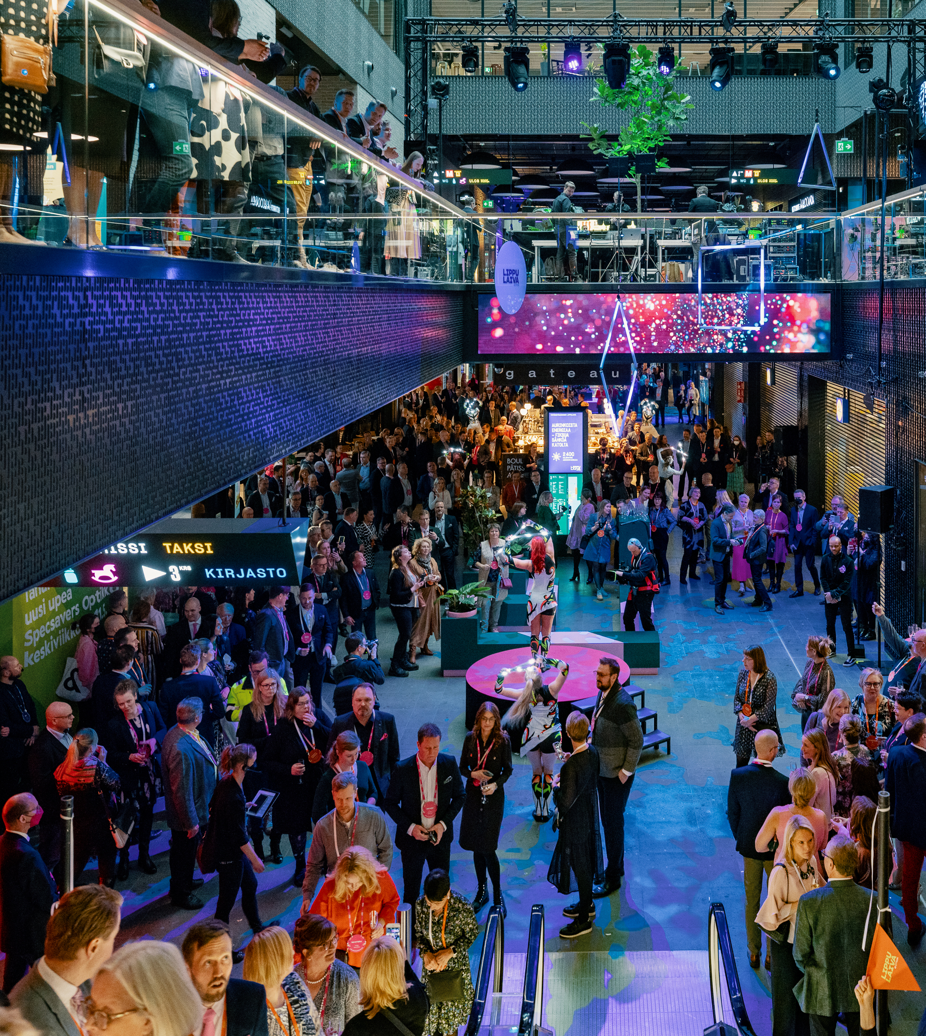
Bond Maturity Schedule (Expanded Solo)
Bond Maturity Schedule Inc. G City Europe
As of June 30, 2023
2.9 Years
Weighted duration
(Bonds)
3.3%
Average interest rate of debt
(Bonds)
LIPPULAIVA | FINLAND
Notes:
אני בשקף 18
סה"כ עד תום שנת 2024 יש לנו פרעונות אג"ח של 3.5 מיליארד ש"ח לעומת כ- 4.2 מיליארד ש"ח
במהלך הרבעון ולאחריו ביצענו ביי-בק של האג"ח של אטריום(סה"כ כ- 81 מיליון אירו), בעיקר של הסדרה העומדת לפירעון בשנת 2025, צריך לזכור שבאטריום היה ליום החתך כ- 200 מיליון אירו ועוד קו אשראי חתום לא מנוצל של כ- 300 מיליון אירו. אחד הדברים המהותיים בהשלמת המיזוג עם אטריום היא האפשרות לנהל את המזומן בקבוצה בצורה יעילה יותר. כך אנו יכולים להשתמש במזומן שנמצא בבנק בריבית שלילית של כ- 0.5% לטובת חסכון אמיתי בעלויות המימון שלנו. כל זאת כמובן תוך כדי שמירת הנזילות שלנו ובלי לקצר את מח"מ החוב.
מילה על סיטיקון,
סיטיקון נמצאת ברמת מינוף של כ-40.4% עם יתרות נזילות של כ- 604 מיליון אירו.
סיטיקון מדורגת בדירוג השקעה עם אופק יציב על ידי שלושת חברות הדירוג: Moody’s: Baa3/Stable , S&P: BBB-/Stable ,

Slide 14
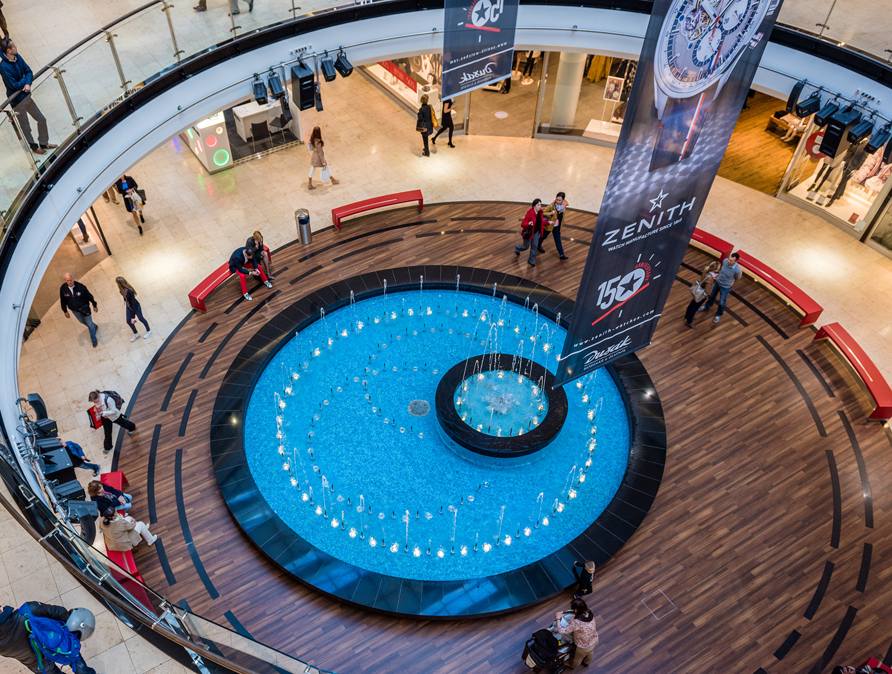
THE HEART OF IT.
CONTACT INFORMATION:
Adi Jemini EVP & CFO
Or Ackerman Head of Capital Markets oackerman@g-city.com +972.3.6948000
ARKADI PANKRAC | PRAGUE

